Slide 1
Inugotchi Documentation
By Logan, Brian, & Sarah

Slide 2
Idea Development
Game Brainstorm w/potential materials
Ideation of Game functionality
Application of functions with physical items

Slide 3
Team Roles
Lead Programmer - Logan
Lead Interaction Designer - Sarah
Lead Artist - Brian

Slide 4
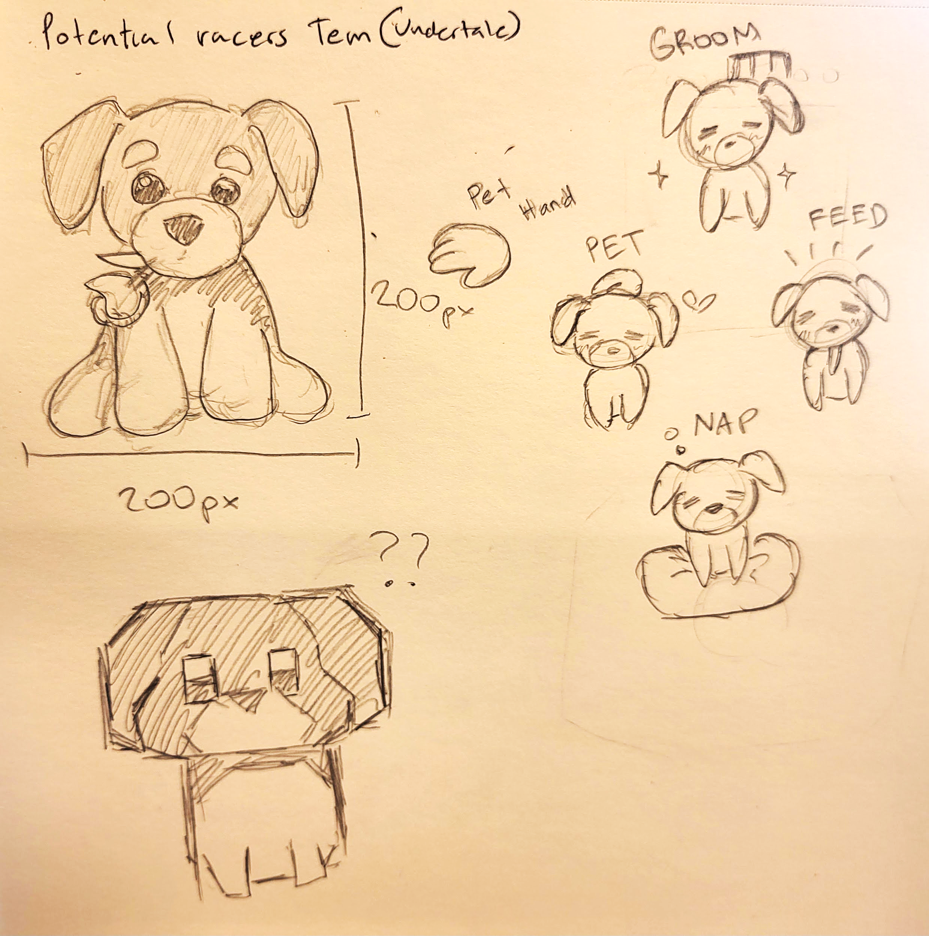
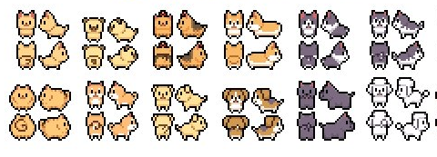
Character Creation
References/Sketches
Process
https://x.com/jenjenrose_art/status/737608097301069824

Slide 5
Final GIFs

Slide 6
Background Assets

Slide 7
Final Backgrounds

